Slide 1
Annual statistical analysis and modelling results
Prepared by:
Krishnakanth Panakarajupally
krishnakanth.590@gmail.com

Slide 2
Scope:
Provide technical and business overview of statistical modelling and analysis performed.
Summarize the results and
Draw inferences and make suggestions
Tools Used:
The input data set was first saved in the form of Coma Separated Values (CSV) file using Microsoft Excel.
Entire data was then imported into SAS 9.4 and data cleaning and statistical analysis were performed.
Note:
SAS code and technical information about the analysis is included in the document attached in the appendix.
For all the applicable statistical analysis, a significance level of 5% is considered.

Slide 3
Data Overview:
Total number of observations = 21061
Total variables = 12 ( day, site, new_customer, platform, visits, distinct_sessions, orders, gross_sales, bounces, add_to_cart, product_page_views, search_page_views )
Variables with missing data (null) = new_customer, platform, gross_sales
Number of observations with at least one missing value = 10686
Number of observation with no missing values = 10375
The following metrics will be generated for each observation:
conversion_rate = orders / visits
bounce_rate = bounces / visits
add_to_cart / visits

Slide 4
Data Overview:
In order to gain more insight of the data, the following variables are created:
month
day_of_week
The values for month and day_of_week will be extracted from variable: day
Handling Missing Data:
Missing data is assumed to be missing completely at random (MCAR).
This means that the probability that an observation is missing is unrelated to its value or to the value of any other variable.
Since there were significant number of observations (10375) with no missing data, observations with missing data will be eliminated and analysis is performed.

Slide 5
Objectives:
Statistical Analysis | Purpose
Frequency Distribution | To find number of occurrences of each of the categorical variable value.
Chi-square test of independence | To find association between categorical variables.
Bar plots | To find association between quantitative variable (orders) and categorical variables.
ANOVA (Analysis of Variance) | To find if association between quantitative variable (orders) and categorical variables is significant.
Correlation Matrix | To find correlation between quantitative variables.
Scatter plots | To visually inspect correlation between quantitative variables
Regression Analysis | To build a regression model for predicting gross sales.

Slide 6
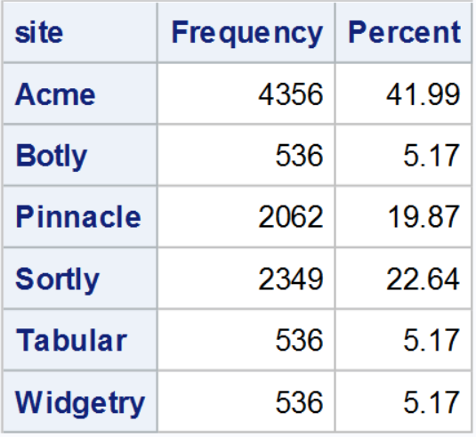
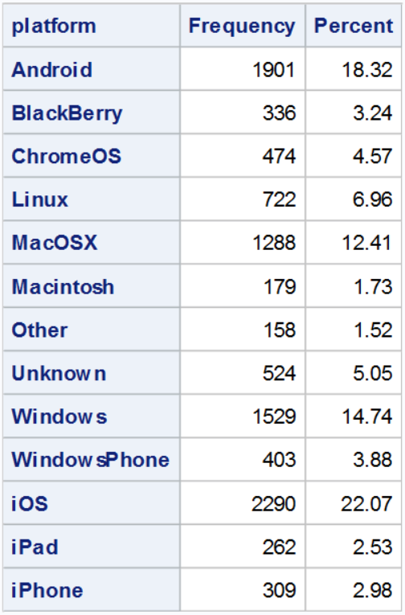
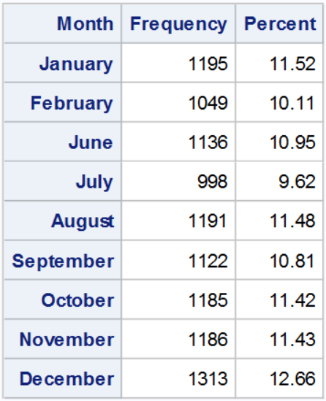
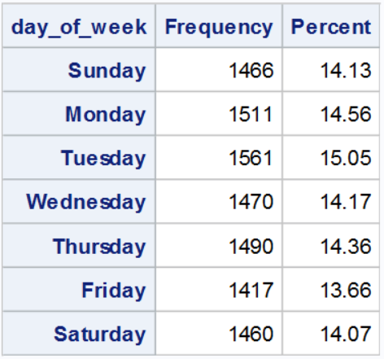
Frequency Distribution
Site
Platform
Month
Day of week
Most number of customers were from Acme, followed by Sorty and Pinnacle
Number of customers were almost same on all days of week
Number of customers were slightly more in the month of December. It must be noted that the data for the months March, April and May is missing.
Users of iOS visited most number of times, followed by users of Android and Windows

Slide 7
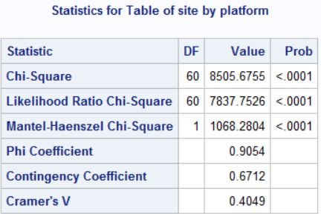
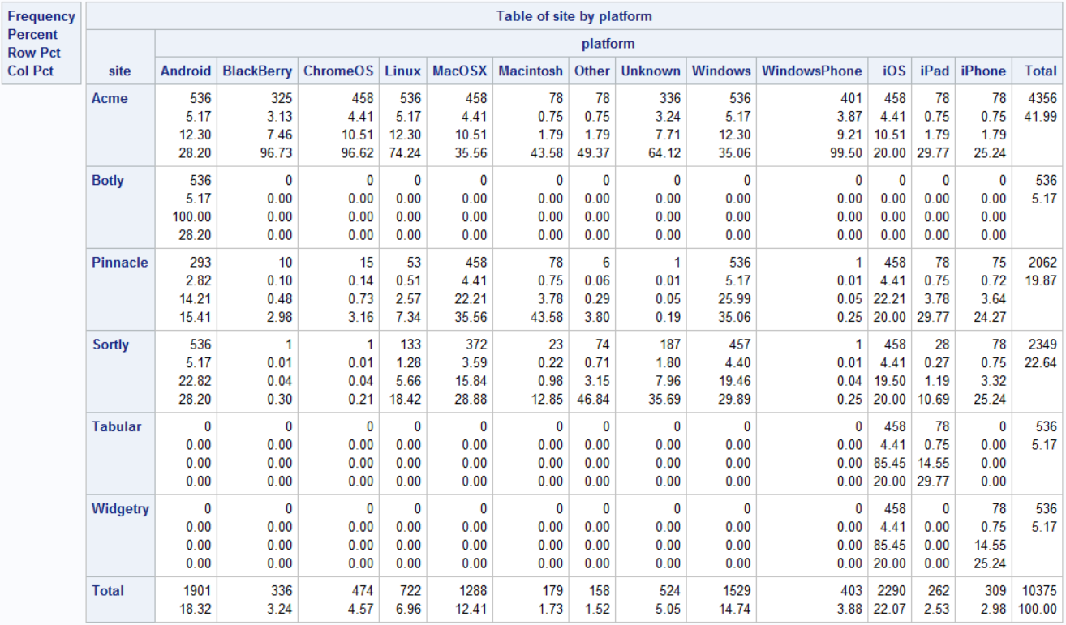
Chi-square Test of Independence – Site vs Platform:
Frequency Distribution of Site by Platform
The probability value for the Chi-square statistic is significant at 0.05 level. Hence, we conclude that Site and Platform are dependent.
The Phi Coefficient is 0.9054, which implies a strong association between Site and Platform
There are no platforms other than iOS and iPhone for Tabular and Widgetry.
Botly has users only from Android platform

Slide 8
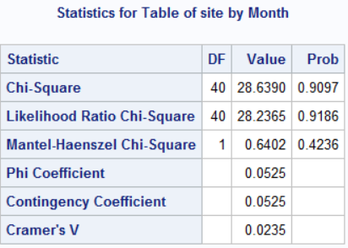
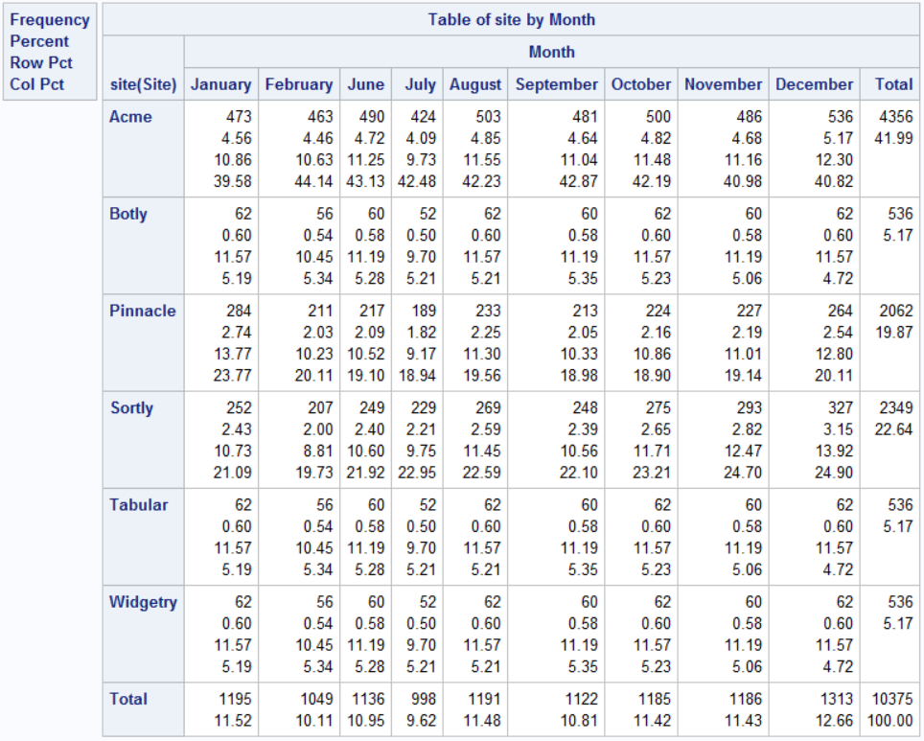
Chi-square Test of Independence – Site vs Month:
Frequency Distribution of Site by Month
Probability value for the Chi-square statistic is 0.9097.
The variables Site and Month are independent.
It can be observed from the table that the customers from all sites are evenly distributed over all months.

Slide 9
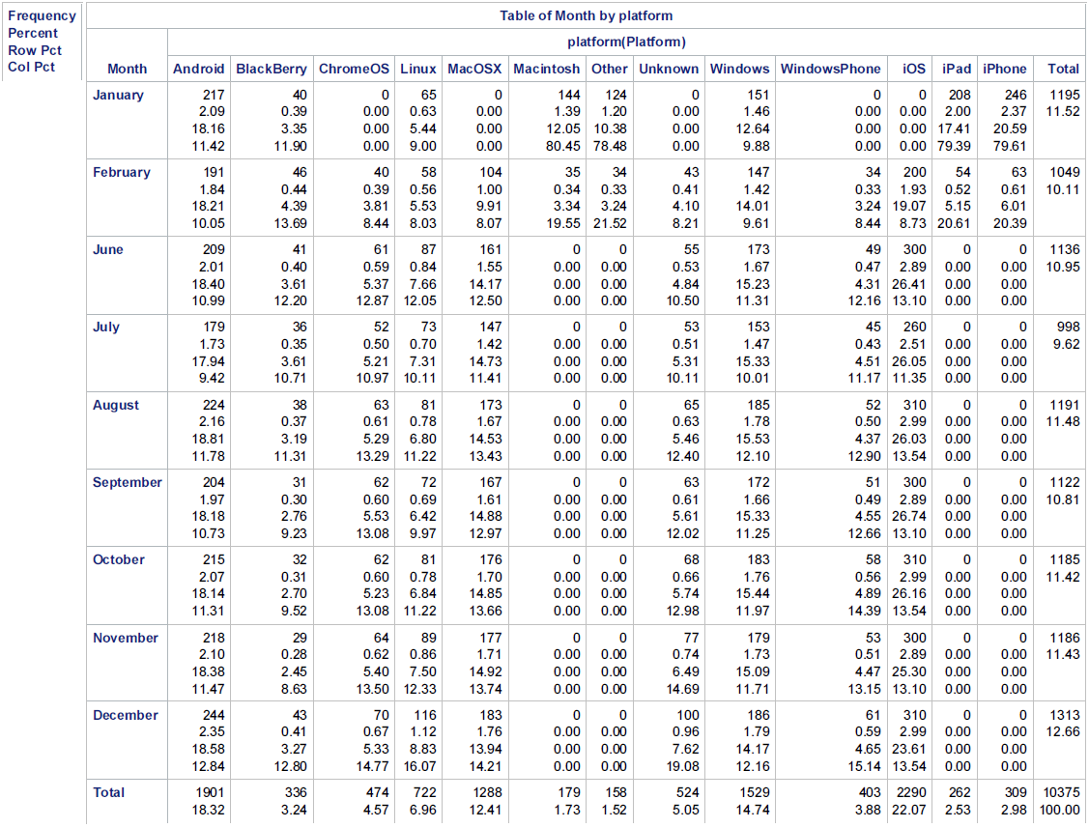
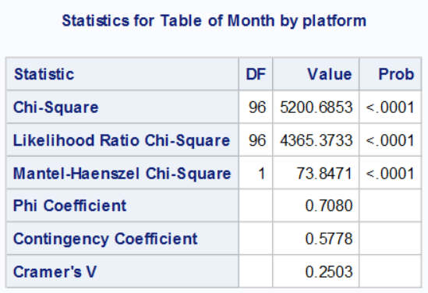
Chi-square Test of Independence – Month vs Platform:
Probability value for the Chi-square statistic is less than 0.001.
There is strong association between variables Month and Platform.
There are no users from platforms: Macintosh, Other, iPad, and iPhone from June to December.
There are no users from Platforms ChromeOS, MacOSX, Unknown, WindowsPhone, and iOS in the month January.

Slide 10
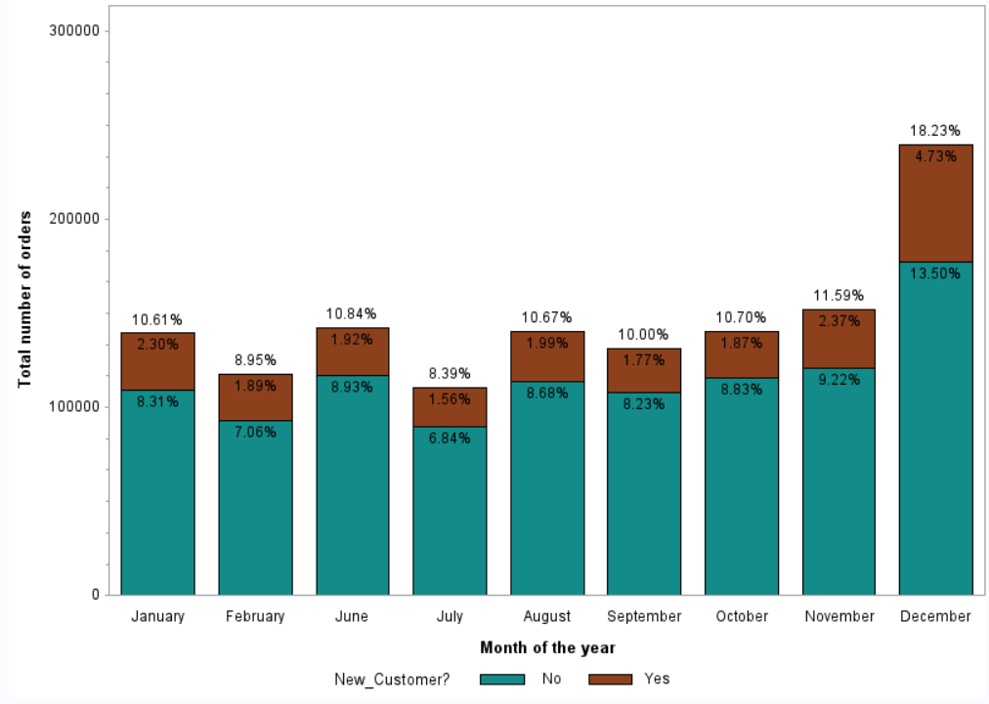
Bar Plot:
Distribution of orders by Month:
18.23% of the total orders were generated in the month of December.
The percentage of orders from returning customers is greater than percentage of orders from new customers in every month.
Least number of orders were recorded in the month of July.
Orders in some of the months can be increased by offering discounts on days such as Independence Day (July), Labor Day (September), Halloween (October), Thanks Giving day (November) etc.

Slide 11
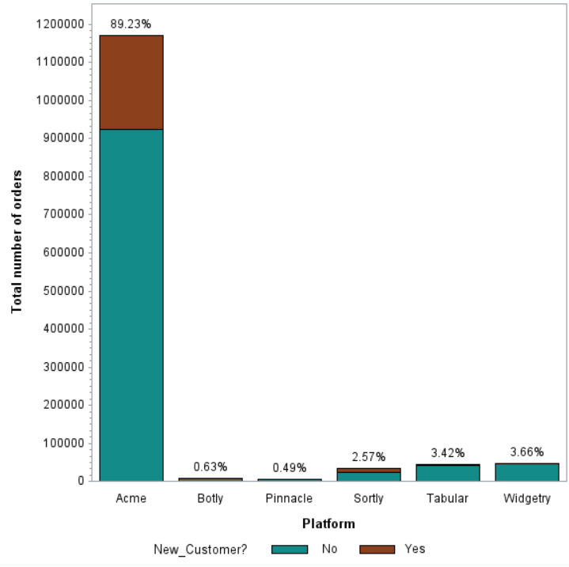
Bar Plot:
Distribution of orders by Site:
Predominant number of orders (89.23%) were from the site Acme.
Pinnacle and Botly generated least percentage of orders, with 0.49% and 0.63% respectively.
From the frequency distribution table, it was observed that 41.99 customers are from Acme, 22.64% from Sortly, 19.87% from Pinnacle, 5.17% from each of Botly, Tabular, Widgetry.
But, the percentage of orders are not analogous with the percentage of customers for each site.
From the data, it is evident that most of the orders were from returning customers, which implies that once a customer is always a customer.
Promotional offers to new customers might help in attracting them and new customers might potentially become returning customers.

Slide 12
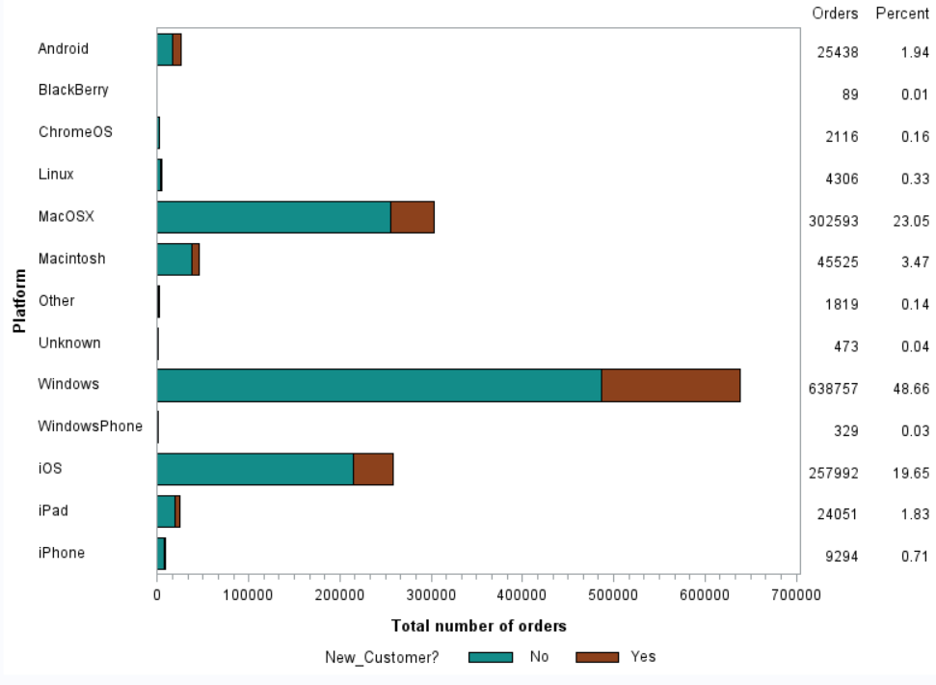
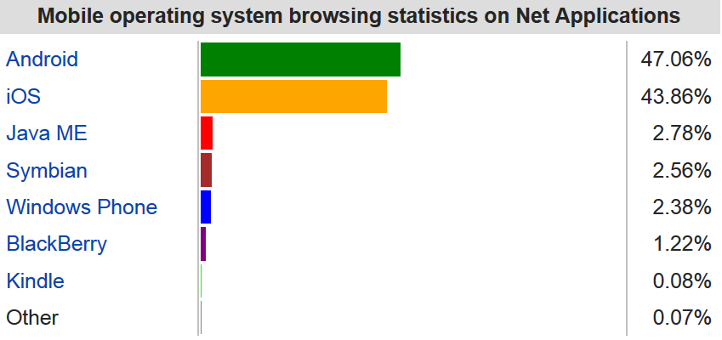
Bar Plot:
Distribution of orders by Platform:
Highest percentage of orders were made from Windows (48.66) platform, followed by MacOSX(23.05%) and iOS (19.65%).
Least percentage of orders were from the platform BlackBerry.
According to Wikipedia, Android(47.06%) has highest mobile internet usage share, followed by iOS (43.86%).
From the analysis, it is observed that only 1.94% of the total orders were generated from Android platform, where as iOS has a share of 19.65%. Since Android has major share in internet usage, there is a scope for improving the number of orders from Android users, by offering special discounts to users ordering from Android platform.

Slide 13
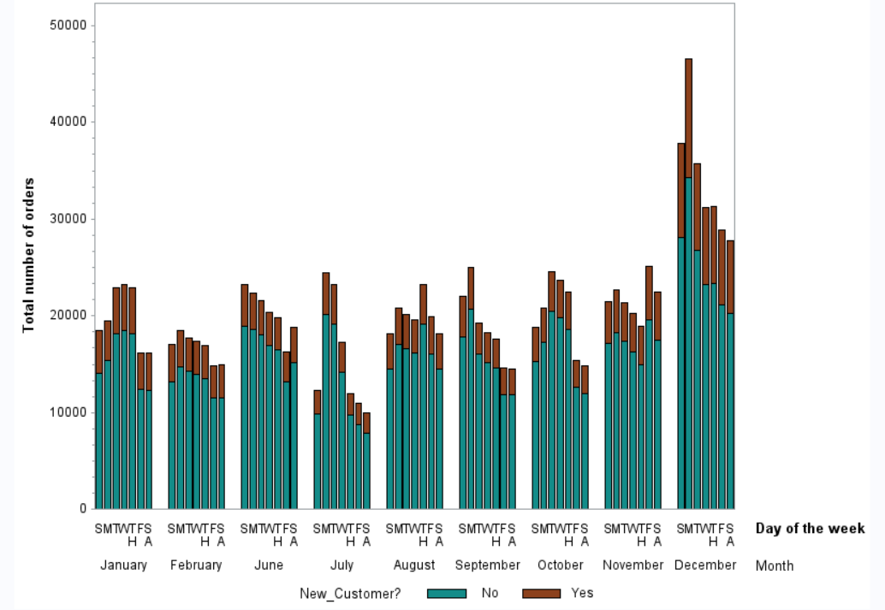
Bar Plot:
Distribution of orders by Day of week:
From visual analysis, it can be observed that in most of the moths, highest number of orders were on Monday.
The number of orders then kept on decreasing as the week progressed.
The least number of orders were observed on Saturdays
ANOVA test will be performed on this data to determine if the observed difference is statistically significant.

Slide 14
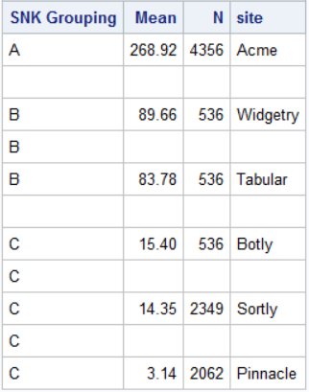
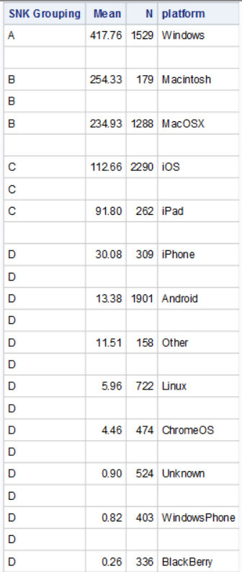
Analysis of Variance (ANOVA):
Orders vs Site
Orders vs Platform
Determined SNK grouping value for each value of categorical variable.
Values with different SNK grouping value are significantly different.
For variable Site, Acme has grouping value of A, Widgetry and Tabular has B and others have C.
Hence, we conclude that the number of orders from Acme are significantly different from number of orders from Widgetry and Tabular, which are significantly different from Botly, Sortly and Pinnacle.
For variable Platform, Windows is grouped separately, denoting that number of orders from Windows platform are significantly different from orders from other platforms.
The mean number of orders for platform can also be noted in the table.

Slide 15
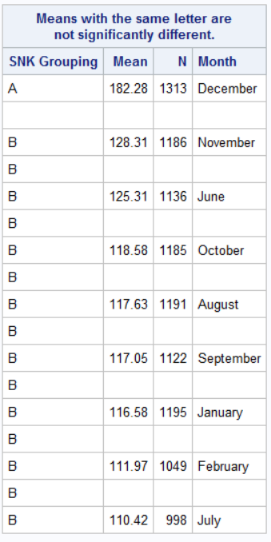
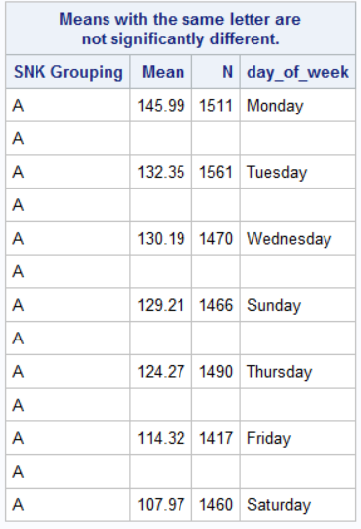
Analysis of Variance (ANOVA):
Orders vs Month
For categorical variable Month, the number of orders in December are significantly different from the number of orders in other months.
Number of orders in all others months are not significantly different.
The result is inline with the visual analysis performed using Bar plots.
The number of orders are not significantly different on any particular day of the week.
Even though from the visual analysis it appeared as if the orders were high on Monday, it is not statistically significant.
Orders vs Day of week

Slide 16
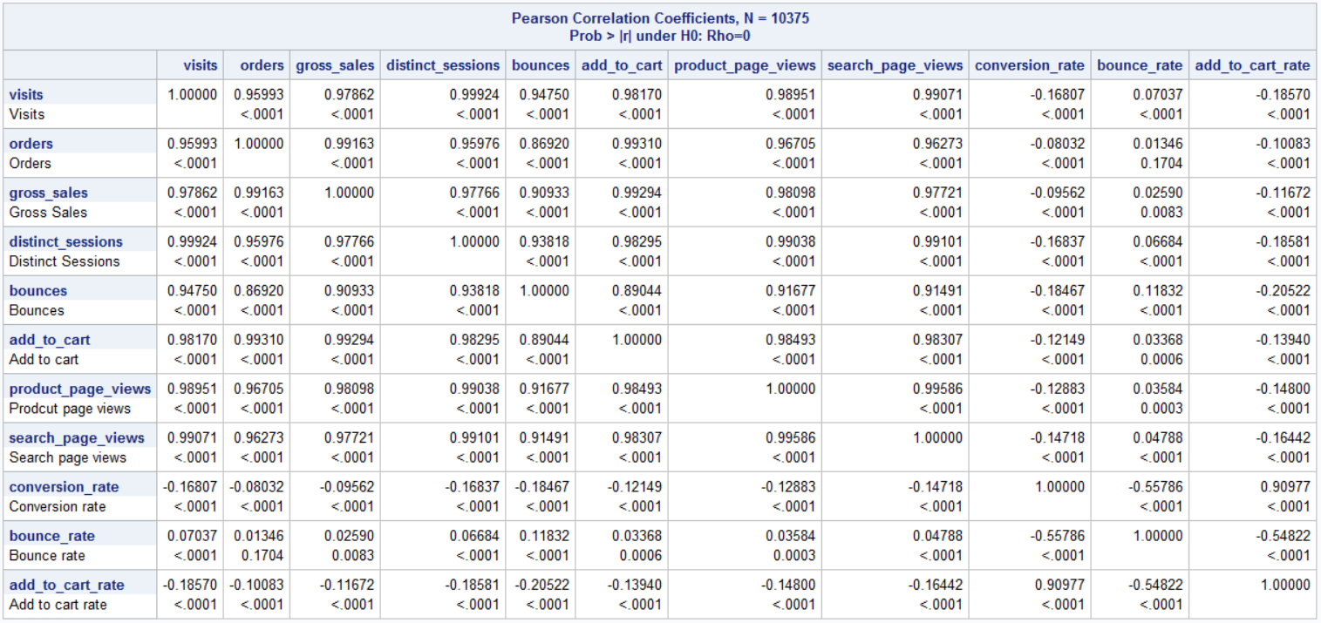
Correlation Matrix:
Variables: visits, orders, gross_sales, distinct_sessions, bounces, add_to_cart, product_page_views, search_page_views are highly correlated.
Since there is high correlation between several variables, to avoid the issue of multicollinearity, some of these variables will be excluded from the regression model.

Slide 17
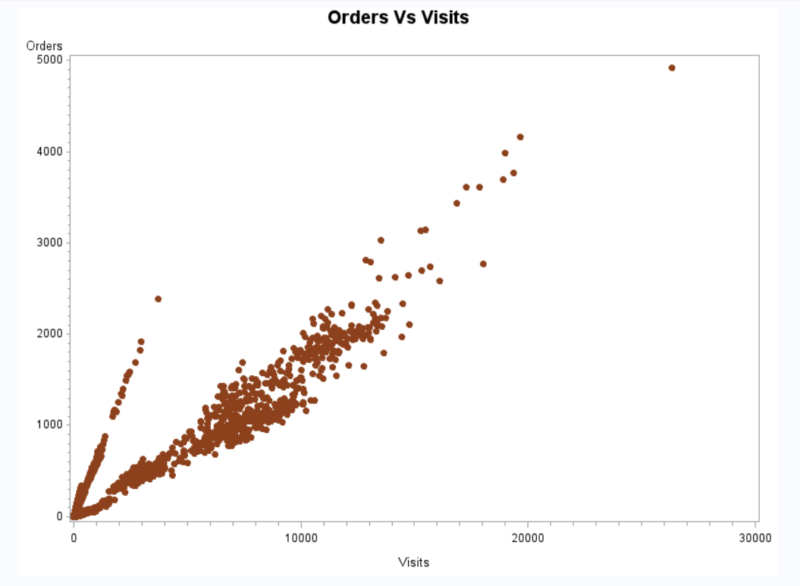
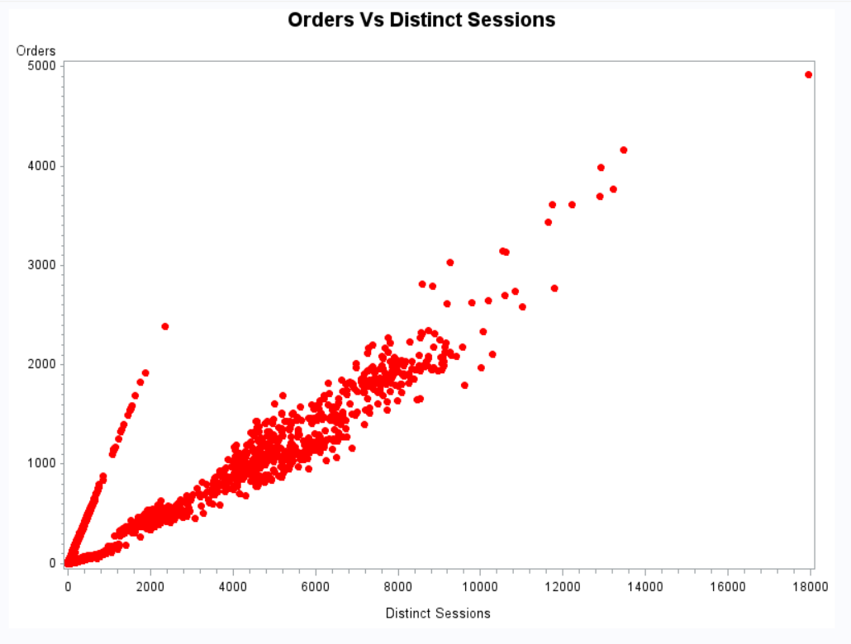
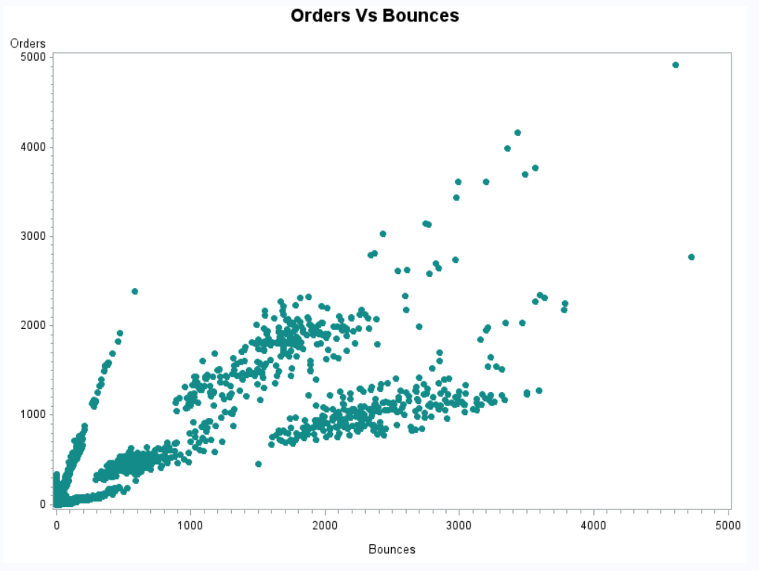
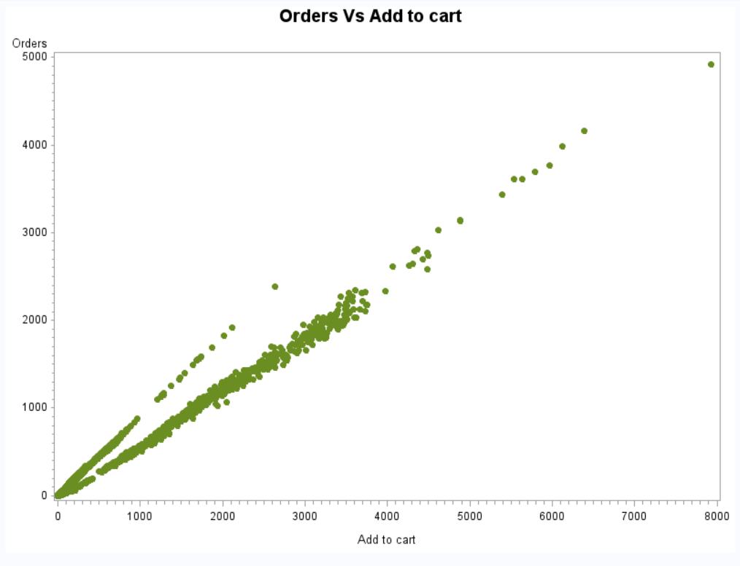
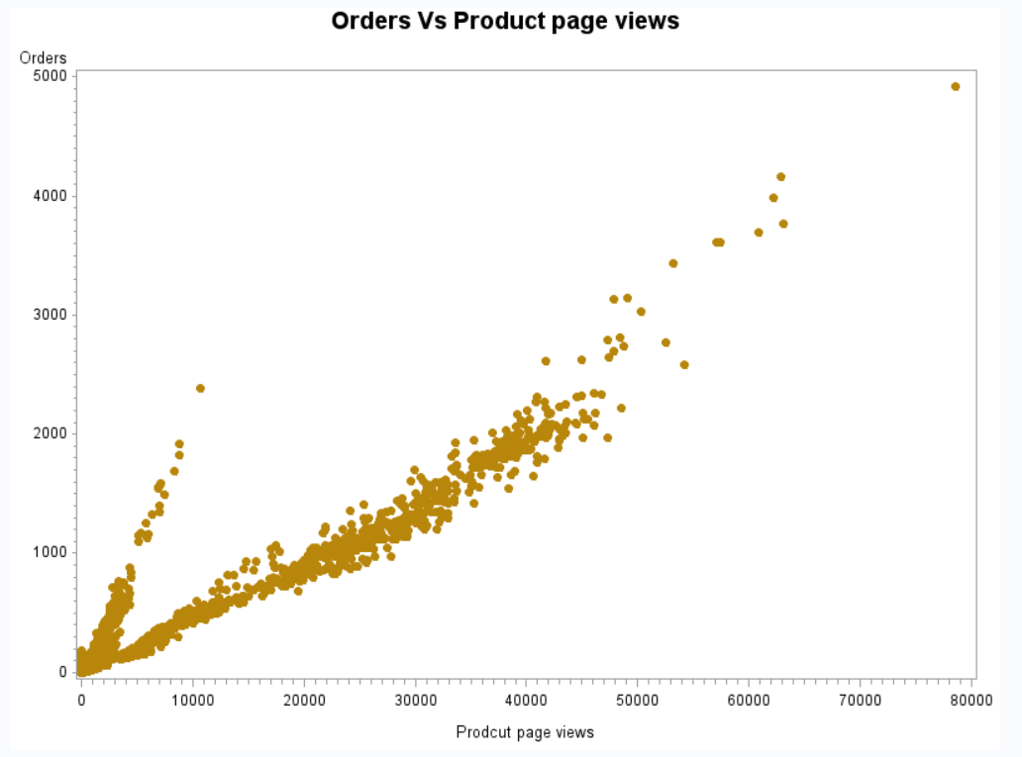
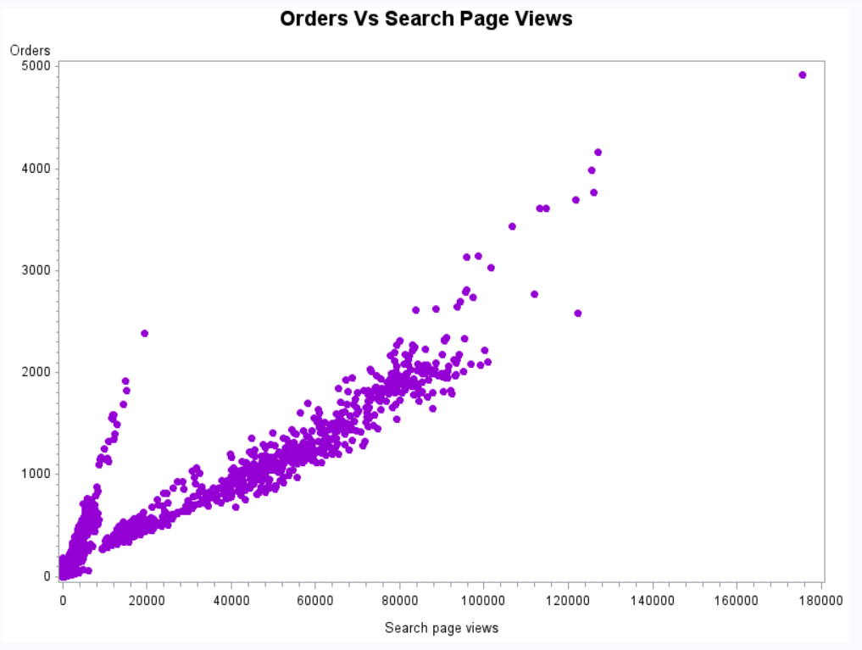
Scatter Plots:
There is a high positive correlation between the quantitative variables displayed above.

Slide 18
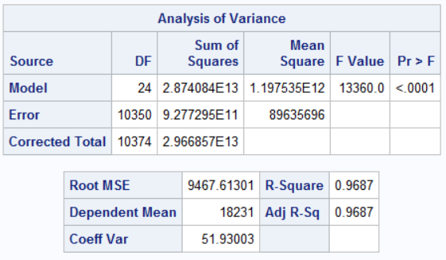
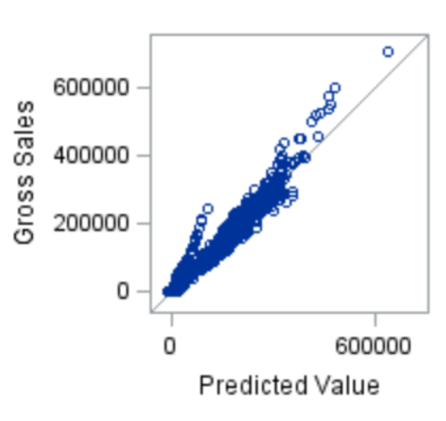
Regression (Predicting gross sales):
A regression model is built to predict gross sales (response variable) by using new_customer, visits, bounce_rate, add_to_cart_rate, site, platform, and month as explanatory variables.
Dummy variables were created for categorical variables site, platform and month, by using reference level coding.
The regression model is statistically significant with probability of less than 0.0001
The points on Gross Sales Vs Predict Value graph are tightly packed around the 45⁰ line, which indicates that the model is accurate in predicting gross_sales.

Slide 19
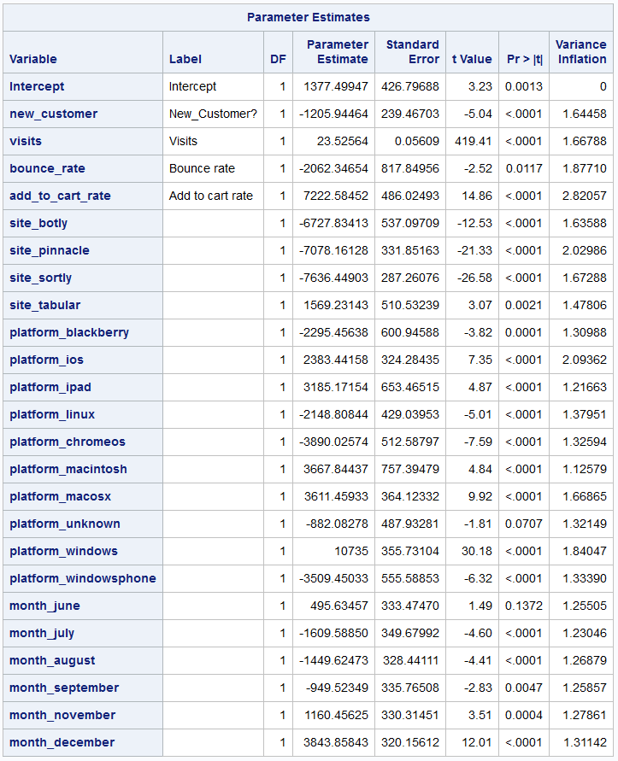
Regression (Predicting gross sales):
The parameter estimates for the regression equation are shown in the table.
The Variation Inflation Factor for all the variables is under control and all the coefficients are statistically significant.
Interpretation:
When compared with returning customer, a new customer generates 1205 units less sales.
As bounce_rate increases by one unit, sales decrease by 2062 units.
If a customer is known to be visiting site botly, pinnacle, and sortly, then the sales are decreased by 6727, 7078, 7636 respectively, with reference to sales when site is Acme.

Slide 20
Regression (Predicting gross sales):
If a customer is known to be from platform blackberry, linux, chromeos, unknown, windowsphone, then the sales will drop by 2295, 2148, 3890, 882, 3509 units respectively, with reference to sales from Android platform.
If a customer is known to be from platform ios, ipad, macintosh, macosx, windows, then the sales will be increase by 2383, 3185, 3667, 3611, 10735 respectively, with reference to sales from Android platform.
If a customer is known to visit in the month of December, then gross sales will increase by 3843 units, with reference to sales if the month was January.

Slide 21
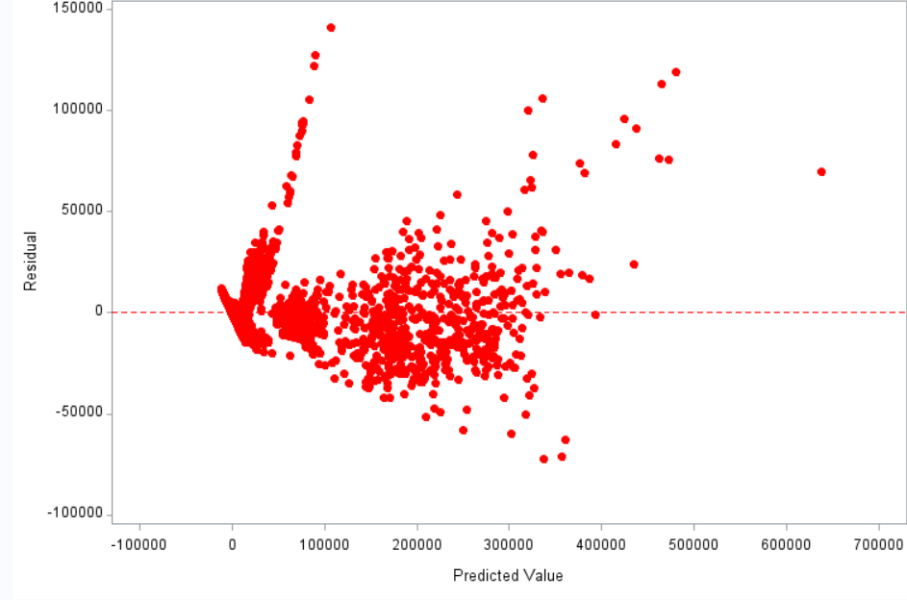
Regression (Predicting gross sales) – Evaluating model performance:
To test the performance, model is applied to the same dataset and estimated values and residuals were calculated
Adjusted R-square value is 0.9687, meaning that 96.87% of variation in gross sales is explained by the explanatory variables in the model.
The sum of residuals was found to be zero, which is an indication that the model is accurate.
From the residual plot, it can be observed that the points are randomly scattered along the zero line. Some points scattered away from zero line are not significant, considering the fact that more than 10,000 values were plotted in the graph.

Slide 22
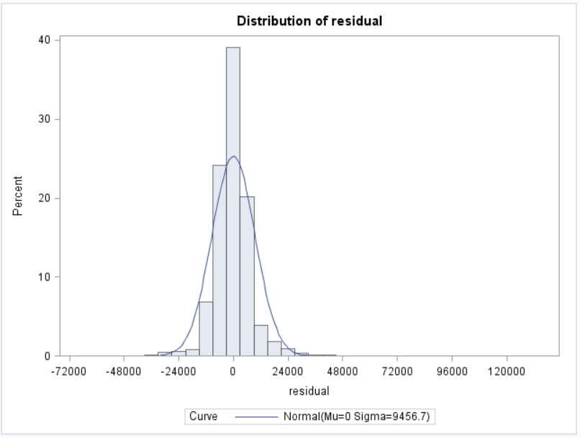
Regression (Predicting gross sales) – Evaluating model performance:
From the histogram of residuals, it can be observed that the residuals follow a normal distribution with mean = 0.
Considering all the earlier mentioned statistical observations, we can conclude that the regression model is accurate, efficient and reliable.

Slide 23
Appendix:
Document containing SAS Code and other technical information. The document can be accessed by double clicking on the icon:

